Slide 1
Activity Diagrams
Modeling a work flow
Modeling an operation
Forward and reverse engineering

Slide 2
ACTIVITY DIAGRAM
Activity diagrams are used to model the dynamic aspects of a system.
It involves modeling the sequential (and possibly concurrent) steps in a computational process.
With an activity diagram, you can also model the flow of an object as it moves from state to state at different points in the flow of control.

Slide 3
Activity diagrams may stand alone to visualize, specify, construct, and document the dynamics of a society of objects, or they may be used to model the flow of control of an operation.
Whereas interaction diagrams emphasize the flow of control from object to object, activity diagrams emphasize the flow of control from activity to activity.
An activity is an ongoing nonatomic execution within a state machine.

Slide 4
Activities ultimately result in some action, which is made up of executable atomic computations that results in a change in state of the system or the return of a value.
Activity diagrams are not only important for modeling the dynamic aspects of a system, but also for constructing executable systems through forward and reverse engineering

Slide 5
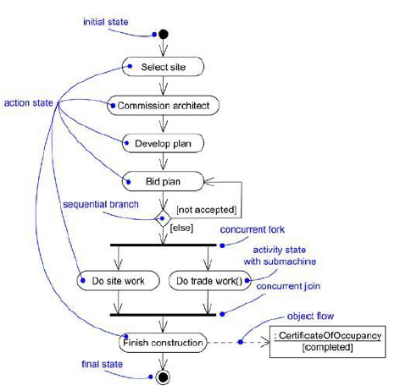

Slide 6
Terms and Concepts
An activity diagram shows the flow from activity to activity.
It is an ongoing nonatomic execution within a state machine.
Activities ultimately result in some action, which is made up of executable
atomic computations that result in a change in state of the system or the return of a value.

Slide 7
Actions encompass calling another operation, sending a signal, creating or destroying an object, or some pure computation, such as evaluating an expression.
Graphically, an activity diagram is a collection of vertices and arcs.
Activity diagrams commonly contain
· Activity states and action states
· Transitions
· Objects

Slide 8
Action States and Activity States
In the flow of control modeled by an activity diagram, things happen. You might evaluate some expression that sets the value of an attribute or that returns some value.
Alternately, you might call an operation on an object, send a signal to an object, or even create or destroy an object.
These executable, atomic computations are called action states because they are states of the system, each representing the execution of an action.

Slide 9
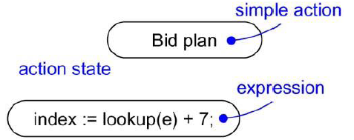

Slide 10
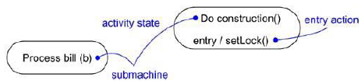
In contrast, activity states can be further decomposed, their activity being represented by other activity diagrams.
Furthermore, activity states are not atomic, meaning that they may be
interrupted and, in general, are considered to take some duration to complete.

Slide 11
An action state as a special case of an activity state. An action state is an activity state that cannot be further decomposed.
Similarly, you can think of an activity state as a composite, whose
flow of control is made up of other activity states and action states.
Zoom into the details of an activity state, and you'll find another activity diagram.
There's no notational distinction between action and activity states, except that an activity state may have additional parts, such as entry and exit actions (actions which are involved on entering and leaving the state, respectively) and submachine specifications.

Slide 12
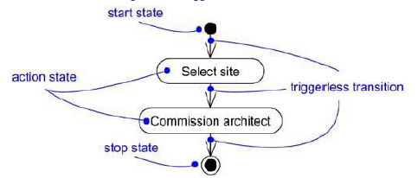
Triggerless transitions
Triggerless transitions may have guard conditions, meaning that such a transition will fire only if that condition is met.
When the action or activity of a state completes, flow of control passes immediately to the next action or activity state.

Slide 13
Branching
,
Branches are a notational convenience, semantically equivalent to multiple transitions with Guards.
Simple, sequential transitions are common, but they aren't the only kind of path you'll need to model a flow of control.
A branch may have one incoming transition and two or more outgoing ones. On each outgoing transition, you place a Boolean expression, which is evaluated only once on entering the branch.

Slide 14
Across all these outgoing transitions, guards should not overlap , but they should cover all possibilities.
As a convenience, we can use the keyword else to mark one outgoing transition, representing the path taken if no other guard expression evaluates to true.
Branching and iteration are possible in interaction diagrams.

Slide 15
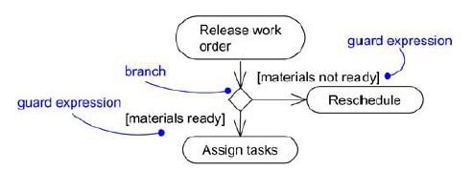

Slide 16
Forking and Joining
Each concurrent flow of control lives in the context of an independent active object, which is typically modeled as either a process or a thread.
Simple and branching sequential transitions are the most common paths we'll find in activity diagrams.
In the UML, we use a synchronization bar to specify the forking and joining of these parallel flows of control. A synchronization bar is rendered as a thick horizontal or vertical line.
A fork may have one incoming transition and two or more outgoing transitions, each of which represents an independent flow of control. Below the fork, the activities associated with each of these paths continues in parallel.
Conceptually, the activities of each of these flows are truly concurrent.

Slide 17
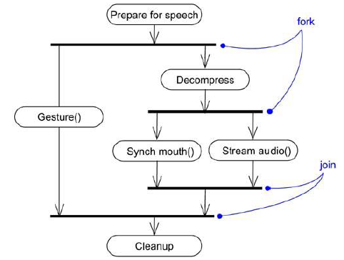

Slide 18
SWIMLANES
A swimlane is a kind of package
Each swimlane has a name unique within its diagram. A swimlane really has no deep semantics, except that it may represent some real-world entity.
Each swimlane represents a high-level responsibility for part of the overall activity of an activity diagram, and each swimlane may eventually be implemented by one or more classes.
In an activity diagram partitioned into swimlanes, every activity belongs to exactly one swimlane, but transitions may cross lanes.

Slide 19
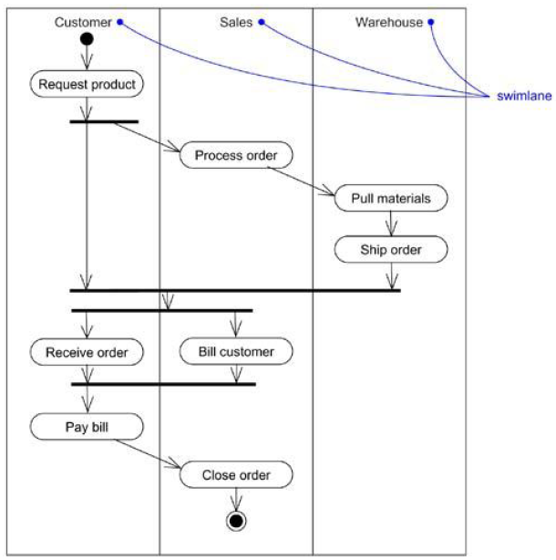

Slide 20
Object Flows
Objects may be involved in the flow of control associated with an activity diagram.
For example, in the workflow of processing an order as in the previous figure, the vocabulary of your problem space will also include such classes as Order and Bill. Instances of these two classes will be produced by certain activities (Process order will create an Order object, for example);
Other activities may modify these objects (for example, Ship order will change the state of the Order object to filled).
The things that are involved in an activity diagram, connected using a dependency to the activity or transition that creates, destroys, or modifies them are specified.
This use of dependency relationships and objects is called an object flow because it represents the participation of an object in a flow of control.

Slide 21
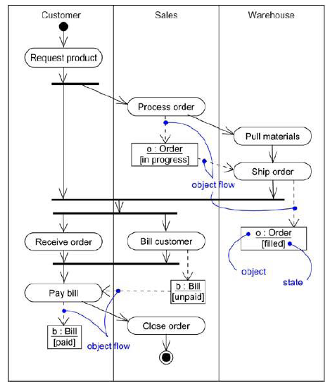

Slide 22
When you model the dynamic aspects of a system, you'll typically use activity diagrams in two ways.
To model a workflows
The activities as viewed by the actors that collaborate with the system are focused.
Workflows often lie on the fringe of software-intensive systems and are used to visualize, specify, construct, and document business processes that involve the system under development.
Hence, modeling object flow is particularly important.
2. To model an operation
Here activity diagrams are used as flowcharts, to model the details of a computation.
In this use of activity diagrams, the modeling of branch, fork, and join states is particularly important.
The context of an activity diagram used in this way involves the parameters of the operation and its local objects.

Slide 23
Modeling a Workflow
No software-intensive system exists in isolation; there's a context in which a system lives, and that context always encompasses actors that interact with the system.
Especially for mission critical, enterprise software, automated systems work in the context of higher-level business processes.
These business processes are kinds of workflows because they
represent the flow of work and objects through the business.

Slide 24
To model a workflow,
Establish a focus for the workflow. For nontrivial systems, it's impossible to show all interesting workflows in one diagram.
Select the business objects that have the high-level responsibilities for parts of the overall workflow.
Identify the preconditions of the workflow's initial state and the postconditions of the workflow's final state.
Beginning at the workflow's initial state, specify the activities and actions that take place over time and render them in the activity diagram as either activity states or action states.
For complicated actions, or for sets of actions that appear multiple times, collapse these into activity states, and provide a separate activity diagram that expands on each.
Render the transitions that connect these activity and action states. Start with the
sequential flows in the workflow first, next consider branching, and only then consider forking and joining.
If there are important objects that are involved in the workflow, render them in the activity diagram, as well. Show their changing values and state as necessary to communicate the intent of the object flow.

Slide 25
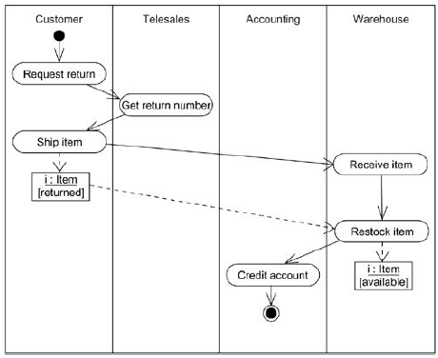
Example

Slide 26
Modeling an Operation
An activity diagram can be attached to any modeling element for the purpose of visualizing, specifying, constructing, and documenting that element's behavior.
Activity diagrams can be attached to classes, interfaces, components, nodes, use cases, and collaborations.
The most common element to which is attached to an activity diagram is an operation.
An activity diagram is simply a flowchart of an operation's actions.
It’s primary advantage is that all the elements in the diagram are semantically tied to a rich underlying model.

Slide 27
To model an operation,
Collect the abstractions that are involved in this operation. This includes the operation's parameters, the attributes of the enclosing class, and certain neighboring classes.
Identify the preconditions at the operation's initial state and the postconditions at the operation's final state. Also identify any invariants of the enclosing class that must hold during the execution of the operation.
Beginning at the operation's initial state, specify the activities and actions that take place over time and render them in the activity diagram as either activity states or action states.
Use branching as necessary to specify conditional paths and iteration.
Only if this operation is owned by an active class, use forking and joining as necessary to specify parallel flows of control.

Slide 28
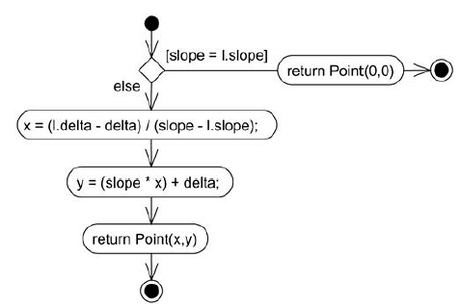
Example

Slide 29
Forward and Reverse Engineering
Forward engineering (the creation of code from a model) is possible for activity diagrams, especially if the context of the diagram is an operation.
For example, using the previous activity diagram, a forward engineering tool could generate the following C++ code for the operation intersection.
Point Line::intersection (l : Line) {
if (slope == l.slope) return Point(0,0);
int x = (l.delta - delta) / (slope - l.slope);
int y = (slope * x) + delta;
return Point(x, y);
}
There's a bit of cleverness here, involving the declaration of the two local variables. A less sophisticated tool might have first declared the two variables and then set their values.

Slide 30
Reverse Engineering
Reverse engineering (the creation of a model from code) is also possible for activity diagrams, especially if the context of the code is the body of an operation.
In particular, the previous diagram could have been generated from the implementation of the class Line.
More interesting than the reverse engineering of a model from code is the animation of a model against the execution of a deployed system.
For example, given the previous diagram, a tool could animate the action states in the diagram as they were dispatched in a running system.
Even better, with this tool also under the control of a debugger, the speed of execution can be controlled, possibly by setting breakpoints to stop the action at interesting points in time to examine the attribute values of individual objects.

Slide 31
THE END

